Slide 1



Joint User and Receive Antenna Selection Algorithms for MU-MIMO Systems with Reduced Complexity
Project ID:21010
Student1:KabyashreeTripathy
Roll No: 201711588
BPUTRegn.No:1701202012
Student 2: Navneet Nipu
Roll No: 201710518
BPUT Regn. No:1701202158
By
Under the guidance of
Mr. Swadhin Mishra
Notes:
B-TECH PROJECT MID-SEM PRESENTATION 2011
BY KHUSHBU KHAN & ISAN SAHOO

Slide 2
Contents
Aims/Objectives
Introduction
System Model
JURAS Scheme for MU-MIMO
Suboptimal Algorithms
Sum capacity from channel matrix
Conclusions
Notes:
B-TECH PROJECT MID-SEM PRESENTATION 2011
BY KHUSHBU KHAN & ISAN SAHOO
2

Slide 3
contents
Future Work
References
Notes:
B-TECH PROJECT MID-SEM PRESENTATION 2011
BY KHUSHBU KHAN & ISAN SAHOO
3

Slide 4
Aims/Objectives
The aim is to show that a joint user and receive antenna selection (JURAS) scheme potentially provides significant gain over a user selection (US) scheme.
Two sub-optimal joint user and antenna selection algorithms with dynamic data stream allocation are also going to analyzed.

Slide 5
Introduction
MU-MIMO schemes have recently attracted attention due to their capability of offering significant gain in system capacity by enabling simultaneous multiplexing of multiuser data streams into the same frequency and time resources.
When users are equipped with multiple antennas, joint user and receive antenna selection may be performed and it potentially provide superior performance to user selection schemes where users utilise all available antennas, especially at high SNR.

Slide 6
Introduction
There are some techniques which provide theoretical sum capacity are DPC (Dirty Paper Coding) ,ZF (Zero Forcing), BD (Block Diagonalization) but they suffer due to high complexity (exhaustive algorithms).
Hence joint user and receive antenna selection (JURAS) is used to achieve high sum capacity at high SNR where two sub optimal algorithms are used to provide near theoretical sum capacity having reduced complexity.

Slide 7
Introduction
Hence in this project we are applying two suboptimal algorithms namely SA-1 and SA-2 having slightly different complexities.
These suboptimal algorithms will find the best combination of user and their receive antennas which will provide maximum possible data rates or sum capacity thereby increasing the data transfer rates.
Although they are suboptimal but they are very useful when number of receive antennas and users increase thereby providing comparatively less computational complexity.

Slide 8
System Model
W₁
W*₁ H*₁
S₁
.
.
.
USER1
L₁ data
streams
N_{t}
S₁
H₁
Y₁
.
.
.
.
.
.
.
.
.
.
.
.
.
.
.
.
.
.
.
.
.
.
.
.
.
.
.
.
.
.
.
.
.
.
.
W_{k}
+
.
.
.
Available:N_{r,1}
Active:M₁
S_{k}
L_{k} data
streams
H_{k}
W*_{k} H*_{k}
.
.
.
USER K
S_{k}
Y_{k}
Adjust precoding matrices
Adjust number of data sreams
Available:N_{r,k}
Active:M_{k}
User Scheduling and precoding design

Slide 9
System Model
The system model consists of a single cell downlink MU MIMO network.
The BASE STATION has N_{t} number of transmitting antennas whereas there are K users having N_{r} receiving antennas with them where M_{k} receiving antennas will be active at a time for a particular user where M_{k} <= Nr .
Our objective function i.e. sum capacity is dependent on the SLNR based precoding matrix which has been given in next slides.
We will assume equal power per data stream power scheme while calculating the SINR for the system.

Slide 10

System Model
The received signal at the mobile station is given as,
$${ y}_{j}=H_{j}W_{j}s_{j}+H_{j}\sum_{k∈U_{i}k≠j}{ }W_{k}s_{k}+v_{j}$$
Received signal
White zero mean complex gaussian noise
Desired signal
Interfering undesired signals

Slide 11
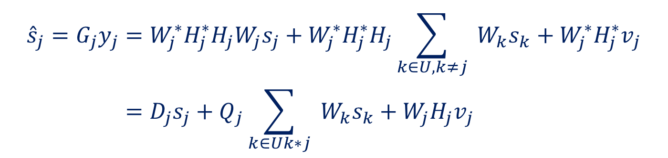

System Model
For SLNR based precoding matrix will be,the precoding matrix is given by,
${ W}_{j}^{o}=ρ⋅{ \text{eigvec} }_{L_{j}}\left\{H_{j}^{∗}H_{j},\left(M_{j}σ_{j}^{2}/E_{j}\right)I+{\tilde{H}}_{j}^{∗}{\tilde{H}}_{j}\right\}\left(N_{t}×L_{j}\right)$
After passing through matched filter in the receiver side, the signal becomes,
$$\begin{aligned}{\hat{s}}_{j}=G_{j}y_{j}&=W_{j}^{∗}H_{j}^{∗}H_{j}W_{j}s_{j}+W_{j}^{∗}H_{j}^{∗}H_{j}\sum_{k∈U,k≠j}{ }W_{k}s_{k}+W_{j}^{∗}H_{j}^{∗}v_{j} \\ &=D_{j}s_{j}+Q_{j}\sum_{k∈Uk∗j}{ }W_{k}s_{k}+W_{j}H_{j}v_{j}\end{aligned}$$

Slide 12
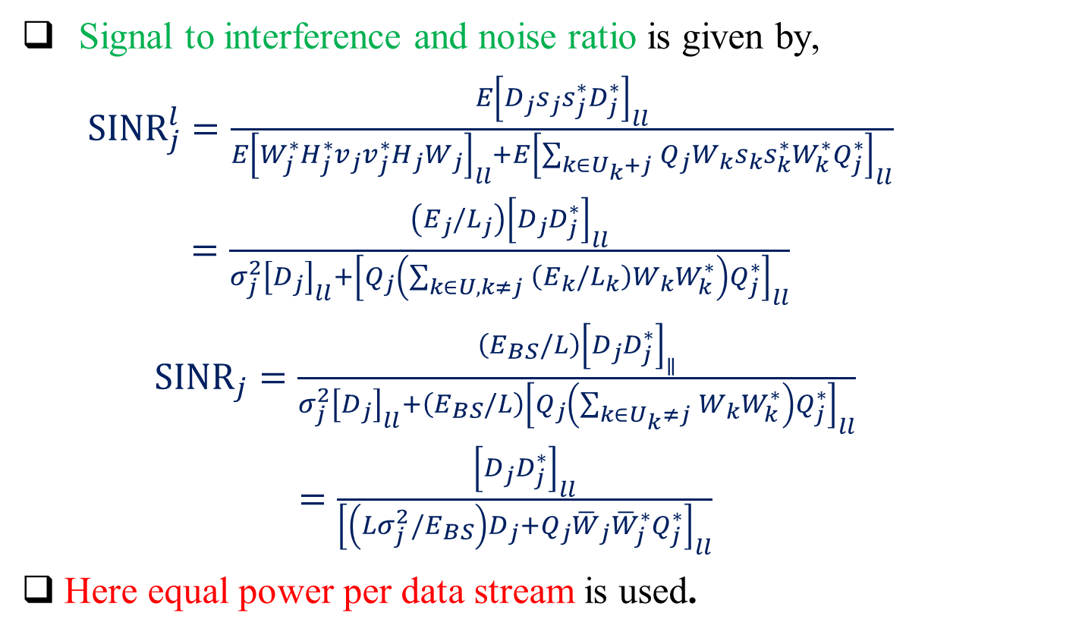
System Model
Signal to interference and noise ratio is given by,
$\begin{aligned}{SINR}_{j}^{l}=\frac{E{\left[D_{j}s_{j}s_{j}^{∗}D_{j}^{∗}\right]}_{ll}}{E{\left[W_{j}^{∗}H_{j}^{∗}v_{j}v_{j}^{∗}H_{j}W_{j}\right]}_{ll}+E{\left[\sum_{k∈U_{k}+j}{ }Q_{j}W_{k}s_{k}s_{k}^{∗}W_{k}^{∗}Q_{j}^{∗}\right]}_{ll}} \\ =\frac{\left(E_{j}/L_{j}\right){\left[D_{j}D_{j}^{∗}\right]}_{ll}}{σ_{j}^{2}{\left[D_{j}\right]}_{ll}+{\left[Q_{j}\left(\sum_{k∈U,k≠j}{ }\left(E_{k}/L_{k}\right)W_{k}W_{k}^{∗}\right)Q_{j}^{∗}\right]}_{ll}}\end{aligned}$
$\begin{aligned}{SINR}_{j}=\frac{\left(E_{BS}/L\right){\left[D_{j}D_{j}^{∗}\right]}_{∥}}{σ_{j}^{2}{\left[D_{j}\right]}_{ll}+\left(E_{BS}/L\right){\left[Q_{j}\left(\sum_{k∈U_{k}≠j}{ }W_{k}W_{k}^{∗}\right)Q_{j}^{∗}\right]}_{ll}} \\ =\frac{{\left[D_{j}D_{j}^{∗}\right]}_{ll}}{{\left[\left(Lσ_{j}^{2}/E_{BS}\right)D_{j}+Q_{j}{\overline{W}}_{j}{\overline{W}}_{j}^{∗}Q_{j}^{∗}\right]}_{ll}}\end{aligned}$
Here equal power per data stream is used.

Slide 13
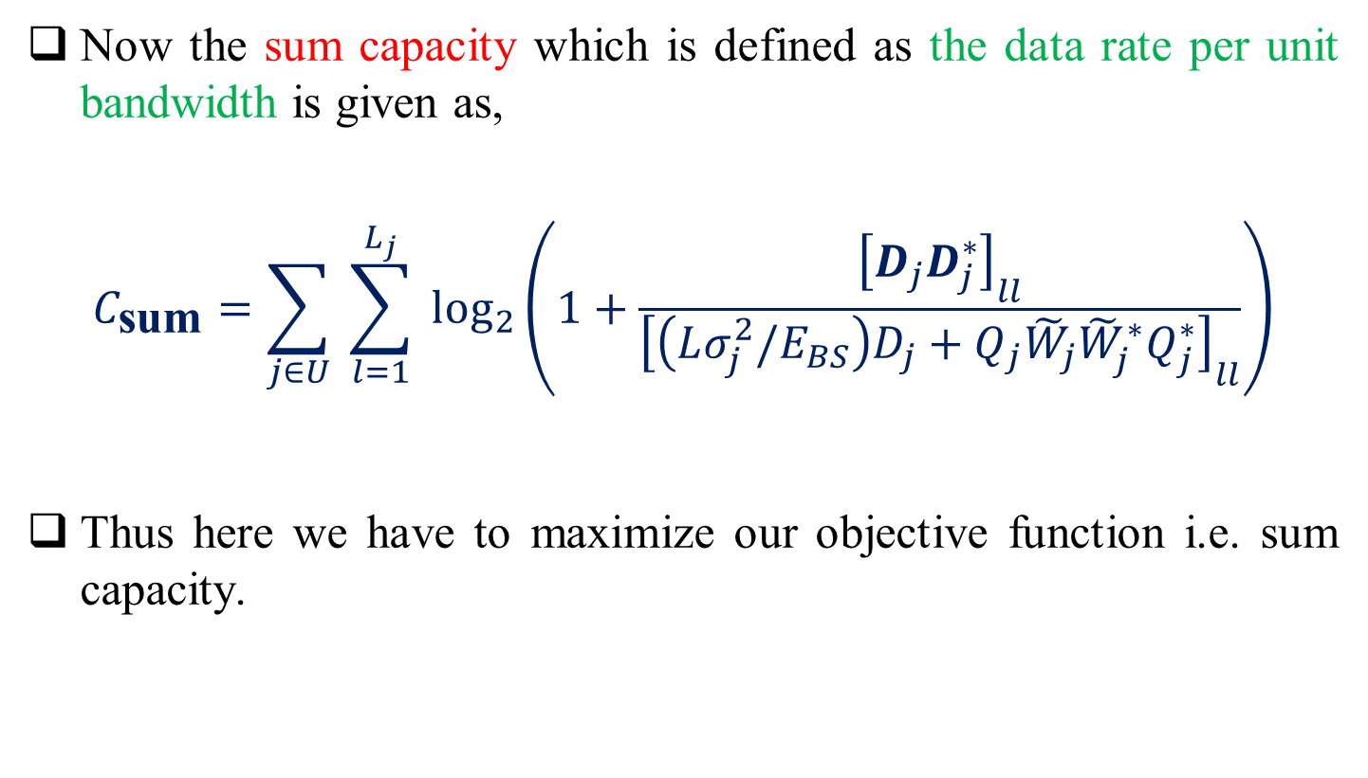
System Model
Now the sum capacity which is defined as the data rate per unit bandwidth is given as,
$$C_{\text{sum}}=\sum_{j∈U}{ }\sum_{l=1}^{L_{j}}{ }\log_{2}\left(1+\frac{{\left[D_{j}D_{j}^{∗}\right]}_{ll}}{{\left[\left(Lσ_{j}^{2}/E_{BS}\right)D_{j}+Q_{j}{\tilde{W}}_{j}{\tilde{W}}_{j}^{∗}Q_{j}^{∗}\right]}_{ll}}\right)$$
Thus here we have to maximize our objective function i.e. sum capacity.

Slide 14
JURAS Scheme for MU-MIMO
JURAS means the joint user and receive antenna selection scheme which is being implemented in this project using two suboptimal algorithms.
In this scheme we first select the receive antenna of a user with highest capacity and then other receive antenna having highest sum capacity and so on so as to procide maximum sum capacity for a particular channel.
Suboptimal algorithm-1 works by updating the user’s precoding matrices and evaluate sum capacity(complexity is somewhat more).

Slide 15
JURAS Scheme for MU-MIMO
Suboptimal algorithm-2 works by considering each receiving antenna as a single user during user selection process and then computes the precoding matrices used for data transmission (complexity is reduced ) .

Slide 16
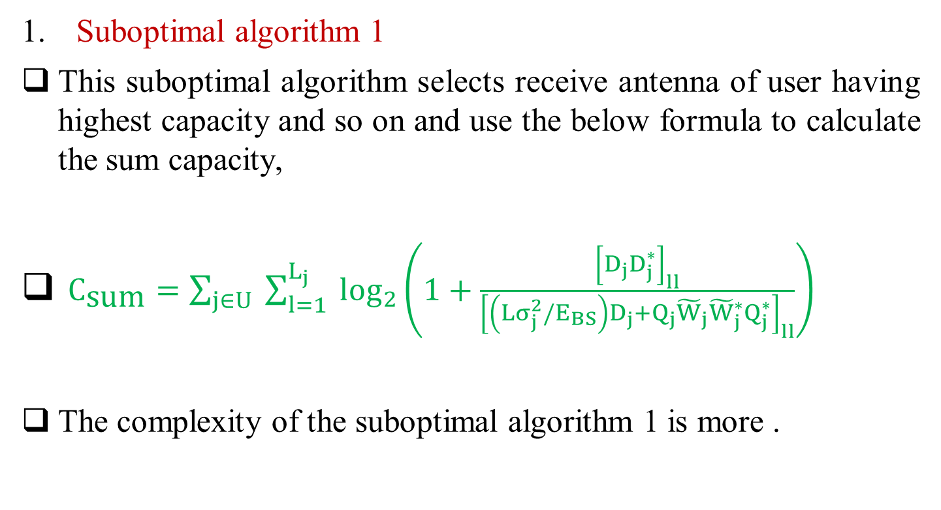
Suboptimal Algorithms
Suboptimal algorithm 1
This suboptimal algorithm selects receive antenna of user having highest capacity and so on and use the below formula to calculate the sum capacity,
$C_{\text{sum}}=\sum_{j∈U}{ }\sum_{l=1}^{L_{j}}{ }\log_{2}\left(1+\frac{{\left[D_{j}D_{j}^{∗}\right]}_{ll}}{{\left[\left(Lσ_{j}^{2}/E_{BS}\right)D_{j}+Q_{j}{\tilde{W}}_{j}{\tilde{W}}_{j}^{∗}Q_{j}^{∗}\right]}_{ll}}\right)$
The complexity of the suboptimal algorithm 1 is more .

Slide 17
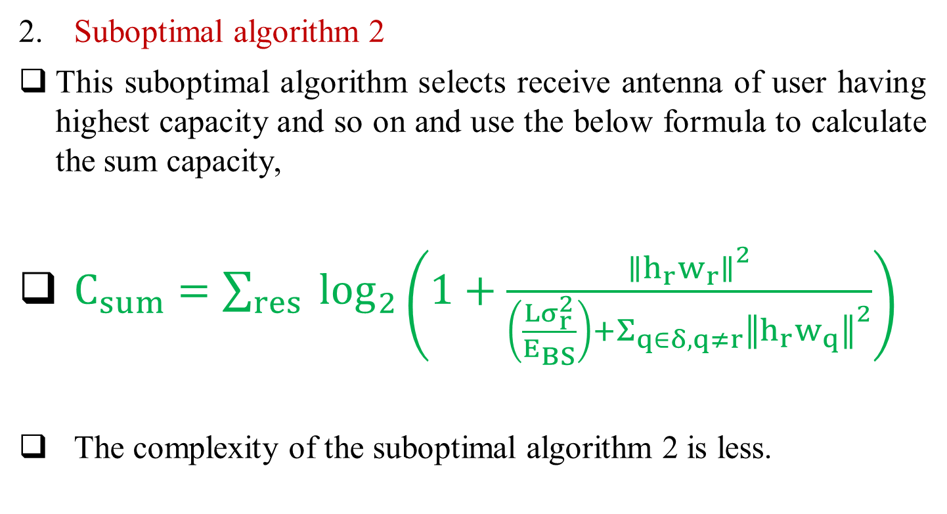
Suboptimal Algorithms
Suboptimal algorithm 2
This suboptimal algorithm selects receive antenna of user having highest capacity and so on and use the below formula to calculate the sum capacity,
$C_{sum}=\sum_{res}{ }\log_{2}\left(1+\frac{{∥h_{r}w_{r}∥}^{2}}{\left(\frac{Lσ_{r}^{2}}{E_{BS}}\right)+Σ_{q∈δ,q≠r}{∥h_{r}w_{q}∥}^{2}}\right)$
The complexity of the suboptimal algorithm 2 is less.

Slide 18
Suboptimal Algorithms
Below is the code to generate the independent complex gaussian channel matrix in matlab where the mean is zero and variance is unity.
n_r=3; % number of receiving antennas
n_t=5; % number of transmitting antennas
K=5; % number of users
Hr=sqrt(1/2)*randn(n_r,n_t,k) + sqrt(1/2)*i1*randn(n_r,n_t,k);
Here we have taken randn function so as to generate the random numbers having mean=0 and variance=1.
The code will generate k number of channel matrix having n_r rows and n_t columns.

Slide 19
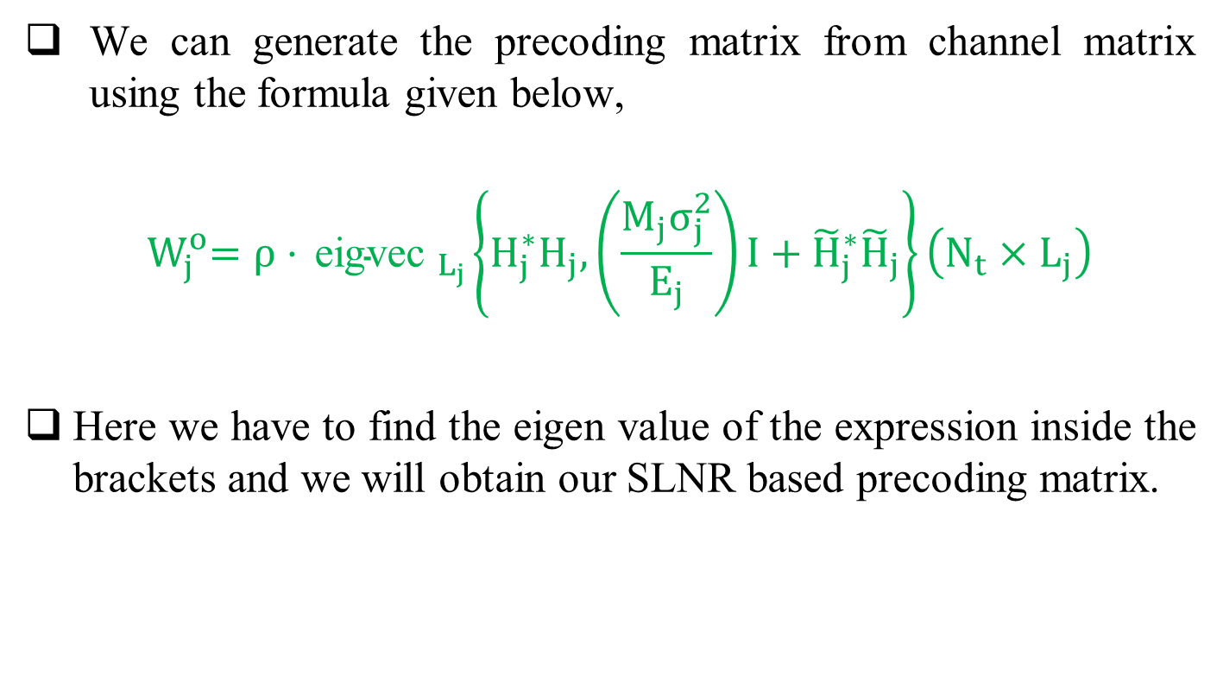
Suboptimal Algorithms
We can generate the precoding matrix from channel matrix using the formula given below,
$${ W}_{j}^{o}=ρ⋅{ \text{eigvec} }_{L_{j}}\left\{H_{j}^{∗}H_{j},\left(\frac{M_{j}σ_{j}^{2}}{E_{j}}\right)I+{\tilde{H}}_{j}^{∗}{\tilde{H}}_{j}\right\}\left(N_{t}×L_{j}\right)$$
Here we have to find the eigen value of the expression inside the brackets and we will obtain our SLNR based precoding matrix.

Slide 20
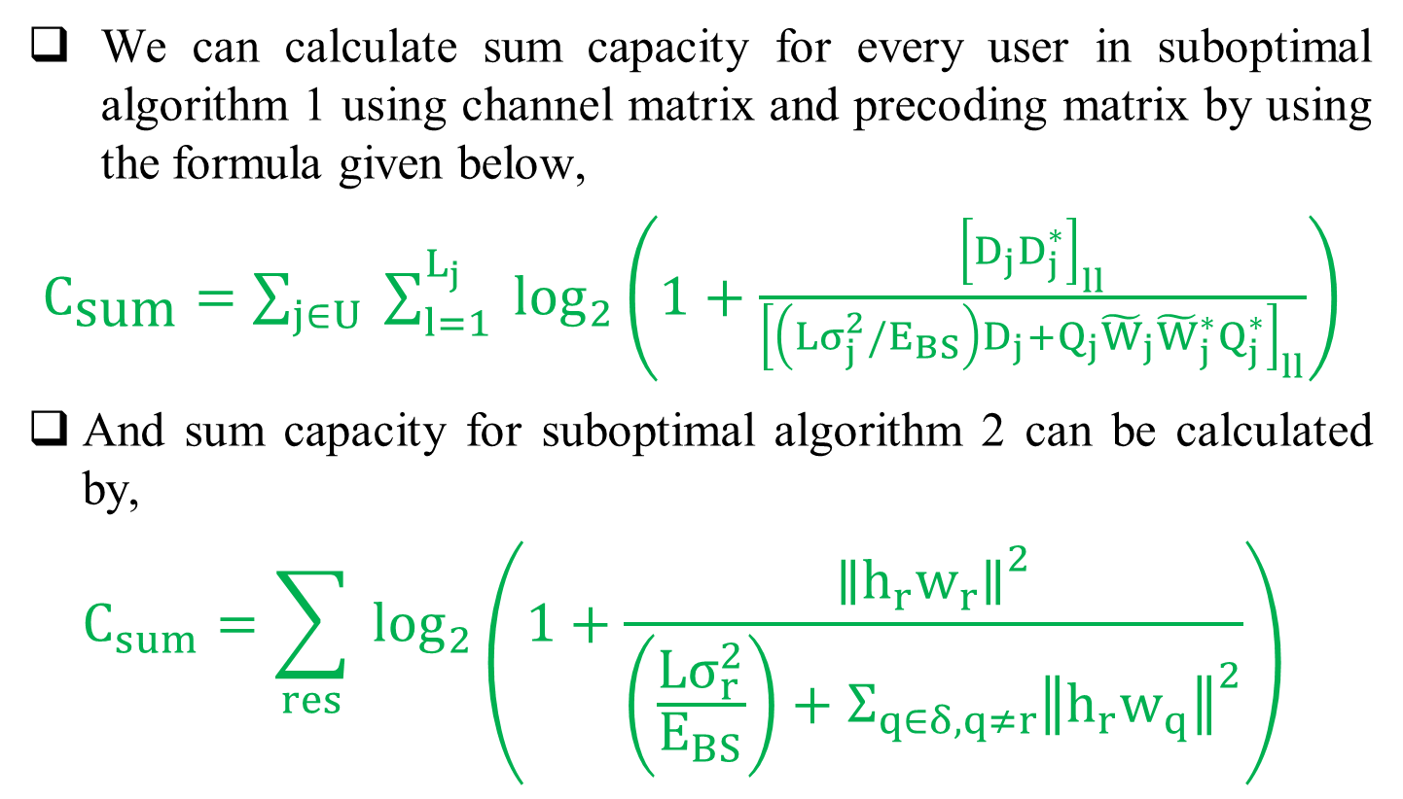
Sum capacity from channel matrix
We can calculate sum capacity for every user in suboptimal algorithm 1 using channel matrix and precoding matrix by using the formula given below,
$C_{\text{sum}}=\sum_{j∈U}{ }\sum_{l=1}^{L_{j}}{ }\log_{2}\left(1+\frac{{\left[D_{j}D_{j}^{∗}\right]}_{ll}}{{\left[\left(Lσ_{j}^{2}/E_{BS}\right)D_{j}+Q_{j}{\tilde{W}}_{j}{\tilde{W}}_{j}^{∗}Q_{j}^{∗}\right]}_{ll}}\right)$
And sum capacity for suboptimal algorithm 2 can be calculated by,
$$C_{sum}=\sum_{res}{ }\log_{2}\left(1+\frac{{∥h_{r}w_{r}∥}^{2}}{\left(\frac{Lσ_{r}^{2}}{E_{BS}}\right)+Σ_{q∈δ,q≠r}{∥h_{r}w_{q}∥}^{2}}\right)$$

Slide 21
Conclusions
The JURAS scheme enhances the performance gain.
The JURAS scheme performance gain is significant at high SNR.
The two JURAS suboptimal algorithms reduced the complexity of computation.

Slide 22
Future Work
Till now we have designed the algorithm for the two suboptimal algorithms and we have generated the complex gaussian zero mean and unity variance channel matrix which will be used to calculate the precoding matrix of the system and then sum capacity which is our objective function.
In the next session we have to implement the algorithms in matlab and calculate the sum capacity and carryout our simulation results so as to analyze every corner of our suboptimal algorithms whether they provide us satisfactory results or not.

Slide 23
Reference
M. Sadek, A. Tarighat, and A. H. Sayed, "A Leakage-Based Precoding Scheme for Downlink Multi-User MIMO Channels," IEEE Transactions on Wireless Communications, vol. 6, no. 5, May 2007.
M. Sadek, A. Tarighat, and A. H. Sayed, "Active Antenna Selection in Multiuser MIMO Communications," IEEE Transactions on Signal Processing, vol. 55, no. 4, pp. 1498 - 1510, Apr 2007.
M. Costa, "Writing on Dirty Paper," IEEE Transactions on Information Theory, vol. 29, no. 3, pp. 439-441, May 1983.

Slide 24
Reference
G. Caire and S. S. (Shitz), "On the Achievable Throughput of a Multiantenna Gaussian Broadcast Channel," IEEE Transactions on Information Theory, vol. 49, no. 7, pp. 1691-1706, Jul 2003.
Q. H. Spencer, A. L. Swindlehurst, and M. Haardt, "Zero-Forcing methods for Downlink Spatial Multiplexing in Multiuser MIMO channels," IEEE Transactions on Signal Processing, vol. 52, no. 2, pp. 461-471, Feb 2004.

Slide 25
Thank You

